Slide 1

Apprenticeships for Young People in England. Is there a payoff?
Based on a report co-financed by The Sutton Trust
Chiara Cavaglia, Sandra McNally*, Guglielmo Ventura
Centre for Vocational Education Research,
London School of Economics (LSE)
Centre for Economic Performance, LSE
* University of Surrey

Slide 2
Motivation
Apprenticeships have gained political momentum in the last decade:
2008 Labour government: one in five of all young people in an apprenticeship within the next decade
2015 Conservative manifesto: committed to 3 millions apprenticeship starts by 2020.
Since April 2017 apprenticeship levy of 0.5% for large employers.
Notes:
Since 2010, commitments to increase:
the number of apprenticeships :
- i.e. new funding opportunities (e.g Higher Apprenticeship Fund, AGE 16-24, etc..)
… and their quality
-promotion of minimum standards (Statement on Apprenticeship Quality and the Richard Review of Apprenticeships, 2012)
… and additional reforms in 2017

Slide 3
Research question
Is there a payoff from having an apprenticeship, over and above school- or college-based education?
Focus on low to “medium” achievers (level 2 and level 3 vocational education)
With admin data

Slide 4
Data
Longitudinal Educational Outcomes:
National Pupil Database (NPD)
Individualised Learner Record (ILR)
Higher Education Statistics Agency (HESA)
HMRC data: administrative data on earnings, employment spells from tax records, from 2004-2015

Slide 5
Sample
Learners who were 16 (and undertook their GCSE exams in 2002/03
AND
whose highest educational qualification is a qualification at level 2 or 3 (≈ 50% of the overall cohort)

Slide 6
Groups
We divide men and women into 2 groups and 3 subgroups:
Level 2
with highest education only academic level 2 (GCSE), who have never started an apprenticeship
with highest education VET level 2, who have never started an apprenticeship
with highest education academic or VET level 2, who have started an apprenticeship
Level 3
with highest education only academic level 3 (A levels), who have never started an apprenticeship
with highest education VET level 3, who have never started an apprenticeship
with highest education academic or VET level 3, who have started an apprenticeship

Slide 7
Who are the apprentices?
When compared to the other 2 groups (academic and vocational without an apprenticeship):
Those starting an apprenticeship are more likely to:
Be white
Speak English as first language
And less likely to:
Come from a disadvantaged background (measured in terms of FSM eligibility), especially for men.
Come from 10% most deprived areas
Finally, their prior performance at school is between those with only academic qualifications (the highest) and those with only vocational qualification (the lowest)

Slide 8
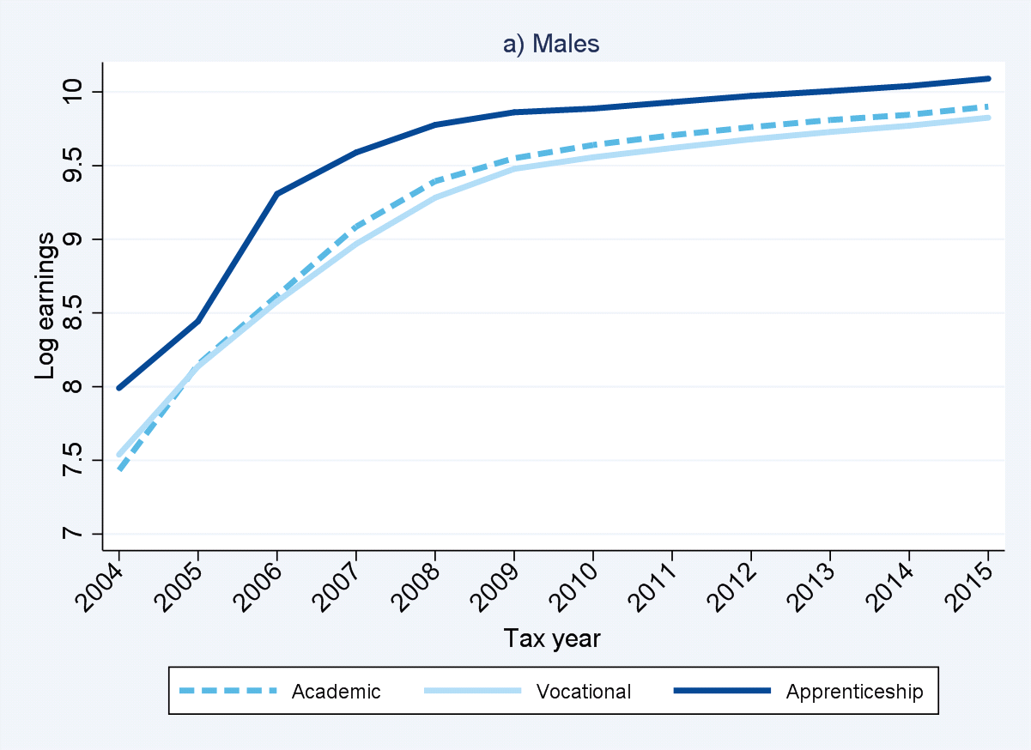
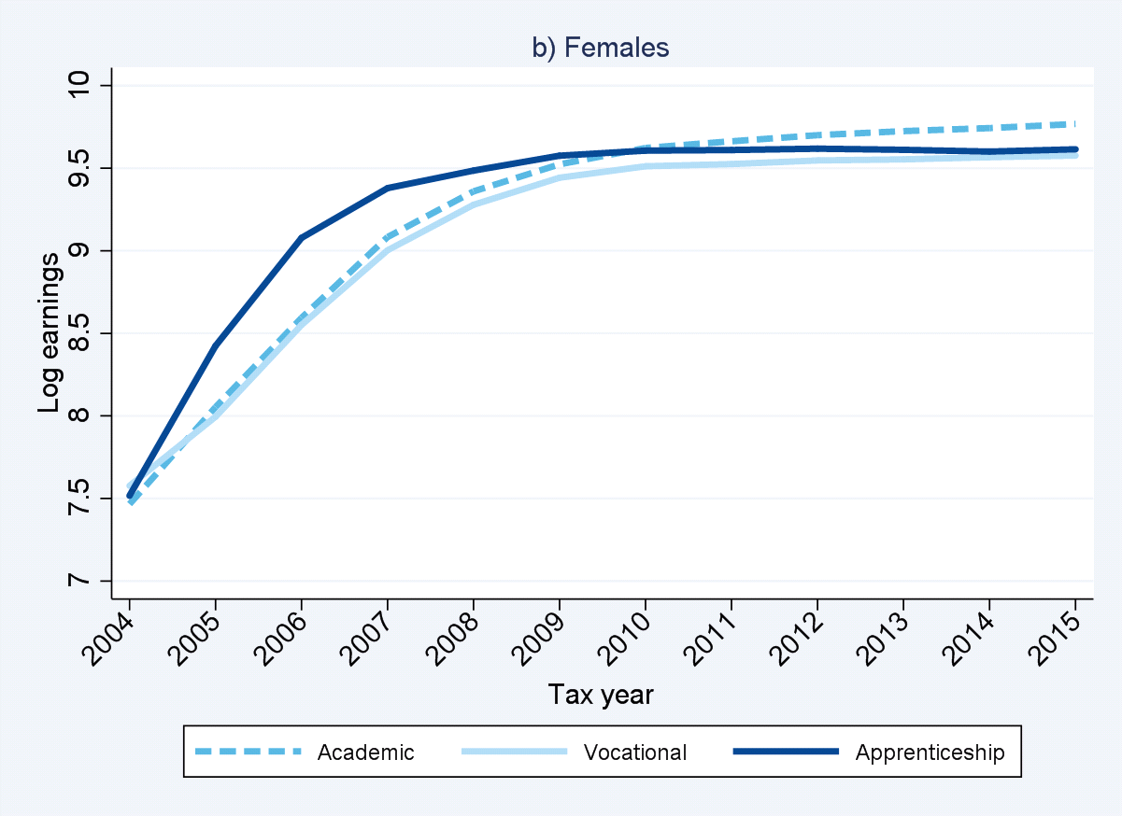
Earnings profiles for females and males
Level 3
Male apprentices> Males with only GCSE > Males with Vocational
Females with GCSE> Female apprentices>=Females with Vocational
….Similar patterns at level 2…

Slide 9
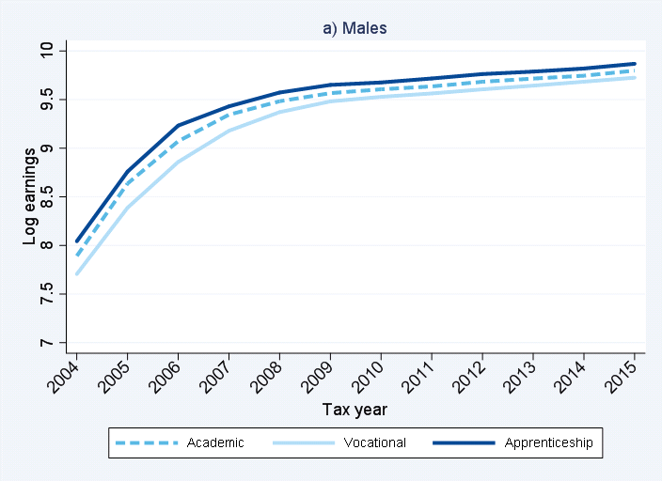
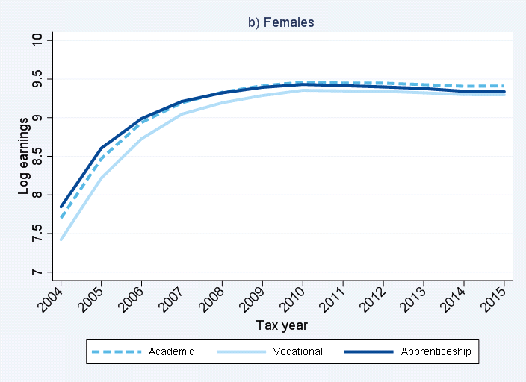
Earnings profiles for females and males
Level 2

Slide 10
The 5 most popular sectors for advanced apprenticeships
Highest associated earnings
Lowest associated earnings
Notes: Ordered from the lowest to the highest associated earnings.
Computed on advances apprenticeship for the 2003 cohort
Source: English administrative data
The most popular sector for men, Engineering, is also the highest paying
The most popular sector for women, Child Development and Well Being, is the lowest paying

Slide 11
Econometric analysis
But the previous statistics are just raw averages
Next, we present the payoffs, after taking into account that learners/workers are different (in terms of ethnicity, background, of ability, etc…)

Slide 12
Earnings payoffs (age 28)
 | Level 2 |  |  |  |  | Level 3
 | Males |  |  | Females |  |  | Males |  |  | Females
 | (1) | (2) |  | (3) | (4) |  | (5) | (6) |  | (7) | (8)
Vocational | -0.006 | 0.074*** |  | 0.042** | 0.107*** |  | -0.018 | 0.023* |  | -0.075*** | -0.046***
With apprenticeship | 0.112*** | 0.229*** |  | 0.038** | 0.145*** |  | 0.242*** | 0.368*** |  | -0.023 | 0.092***
Average earnings academic | £19,709 |  |  | £13,621 |  |  | £22,464 |  |  | £18,500
Additional Controls:
Years of experience |  | ü |  |  | ü |  |  | ü |  |  | ü
* p<0.05, ** p< 0.01, *** p< 0.001
Notes: Yearly gross earnings in 2015 prices. Excluded top and bottom 1% of yearly earnings distribution. Regressions include the following controls: demographic characteristics (White British, English as first language, FSM eligibility, IDACI score), prior attainment in Key Stage 4, prior attainment in Key stage 2 (English and Maths) and secondary schools' fixed effects.
Also…
apprentices earn more if they have completed their apprenticeship, and if their apprenticeship is at level 3
No difference by SES, white vs non-white, if living in London, if living in 10% most deprived areas… after we control for all other characteristics.

Slide 13
Differences by sector
Males
Females
 | Level 2 |  | Level 3 |  |  | Level 2 |  | Level 3
 | (1) |  | (2) |  |  | (1) |  | (2)
Vocational with no apprenticeship | 0.074*** |  | 0.024* |  | Vocational with no apprenticeship | 0.106*** |  | -0.052***
Apprenticeship in Engineering | 0.376*** |  | 0.550*** |  | Apprenticeship in Childcare | 0.082** |  | -0.087***
Apprenticeship in Construction | 0.224*** |  | 0.340*** |  | Apprenticeship in Healthcare | 0.189*** |  | 0.014
Apprenticeship in Administration | 0.163*** |  | 0.206*** |  | Apprenticeship in Administration | 0.197*** |  | 0.174***
Apprenticeship in Transportation | 0.260*** |  | 0.373*** |  | Apprenticeship in Service enterprises | 0.022 |  | -0.068*
Apprenticeship in another sector | 0.192*** |  | 0.268*** |  | Apprenticeship in another sector | 0.189*** |  | 0.142***
Average earnings academic | £19,709 |  | £22,464 |  | Average earnings academic | £13,621 |  | £18,500
* p<0.05, ** p< 0.01, *** p< 0.001
Notes: Yearly gross earnings in 2015 prices. Excluded top and bottom 1% of yearly earnings distribution. Regressions include the
following controls: demographic characteristics (White British, English as first language, FSM eligibility, IDACI score), prior attainment
in Key Stage 4, prior attainment in Key stage 2 (English and Maths) and secondary schools' fixed effects.

Slide 14
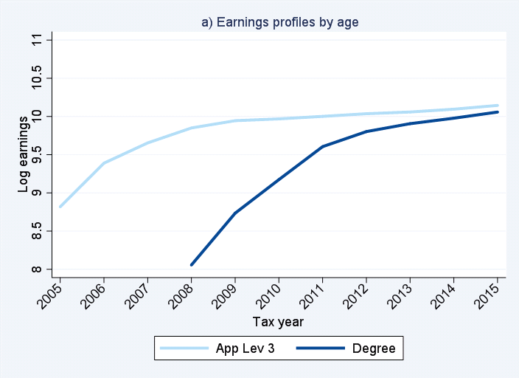
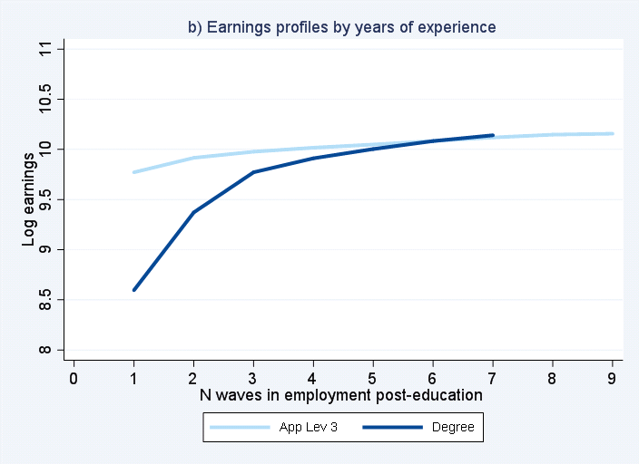
What about male apprentices at level 3 vs male graduates?
If we take into account that workers are different from each other…..

Slide 15
Payoffs of apprentices and graduates
 |  | Change in earnings with respect to:
 |  | Any degree |  | Degree in Engineering
Level 3 apprenticeship in Engineering |  | 0.266*** |  | 0.061
Level 3 apprenticeship in Construction |  | 0.083*** |  | -0.150***
Level 3 apprenticeship in Administration |  | -0.012 |  | -0.208***
Level 3 apprenticeship in Construction |  | 0.062*** |  | -0.150***
Level 3 apprenticeship in another sector |  | 0.068** |  | -0.129***
Additional Controls:
Years of experience |  | ü |  | ü
* p<0.05, ** p< 0.01, *** p< 0.001
Notes: Yearly gross earnings in 2015 prices. Excluded top and bottom 1% of yearly earnings distribution. Regressions include the following controls: demographic characteristics (White British, English as first language, FSM eligibility, IDACI score), prior attainment in Key Stage 4, prior attainment in Key stage 2 (English and Maths) and secondary schools' fixed effects.
We are comparing graduates and apprentices who have completed their qualification

Slide 16
Conclusions
Our study suggests that:
  there are some payoffs associated with apprenticeships, but a lot of heterogeneity:
    according to the sector and level of education
    For males and women
  Some differences in terms of who accesses an apprenticeship by SES, but this does not affect the payoffs.
More research needed
Raises questions about how to expand apprenticeship systems in countries like the UK (and what to tell young people)

Slide 17
Thank you!!!
Any comments are welcome (c.cavaglia@lse.ac.uk)
The full report can be found: http://cver.lse.ac.uk/textonly/cver/pubs/cverdp010.pdf
Or here: https://www.suttontrust.com/research-paper/better-apprenticeships-quality-access-social-mobility/
And very soon… a related paper where we try to deal with selection in order to obtain causal estimates…Check our website for this and other interesting work on skills and education!
http://cver.lse.ac.uk/

Slide 18
Extra material

Slide 19
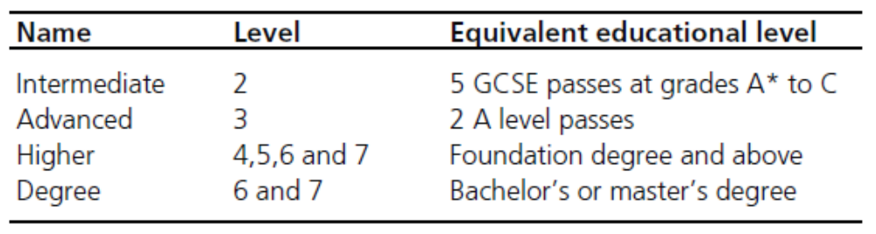
Types of apprenticeships
Year of GCSE exam | Level 2 | Level 3 | Level 4 | Level 5
2002 | 13.43% | 6.07% | 0.00% | 0.00%
2003 | 13.50% | 6.20% | 0.00% | 0.00%
2004 | 14.18% | 6.41% | 0.01% | 0.00%
2005 | 15.21% | 6.62% | 0.05% | 0.00%
2006 | 15.97% | 7.06% | 0.11% | 0.00%
2007 | 17.35% | 7.76% | 0.14% | 0.00%
2008 | 18.43% | 8.49% | 0.18% | 0.00%
Source: English administrative data (2003-2015)

