Slide 1
Higher education funding: a sustainable future?
9:00 – 13:15 | Wednesday 21st March 2018

Slide 2
Welcome
Alun Evans, Chief Executive, British Academy

Slide 3
Opening remarks
Natalie Perera, Executive Director, Education Policy Institute

Slide 4
Appraisal of the current system
David Robinson, Director, Post-16 & Skills, Education Policy Institute

Slide 5

Current system – system ending in 16 days
Features of the current system
Problems system was designed to solve
How system has performed

Slide 6
Key sources:
EPI modelling
IFS BN211 Higher Education funding: Past, present and options for the future
HEPI-HEA Student Academic Experience Survey
OBR fiscal sustainability reports
OECD skills matter
Government statistics: DFE, UCAS, SLC

Slide 7
1. Features of the current system
Government (DfE/SLC)
Repayment
Student / graduate
Loans
Teaching grants
University fees
<= £9,250 p.a.
Maintenance costs
≈ £6,000 p.a.¹
Universities set fees
Cap set by the government
Govt offers loans to pay fees and maintenance
Grants paid only for high cost subjects
1: Source: SLC - 16/17 entrants: Average for those taking maintenance loans on post 16/17 system.
7

Slide 8
Loan terms: example
Only on income over £21K
Residual written off after 30 years
9% of that income
Interest rate 0-3% real terms (RPI, dependent on income)
Repayments over lifetime employment - illustrative graduate
Source: EPI modelling

Slide 9
Tax payer subsidy through write-offs
Taxpayer subsidy – average graduate
Write-offs are intentional taxpayer subsidy
Source: IFS - BN211 Higher Education funding: Past, present and options for the future

Slide 10
More akin to a tax than a loan
Debt repayments - illustrative graduate
Only 24% of graduates (highest earners) due to pay off their debt before they are written off
Debt operates as time limited tax for other 76%
Only 40% of graduates (highest earners) expected to pay any real interest
Source: EPI modelling based on DfE student loans ready reckoner

Slide 11
30+ years to stable system
Student loans: Government outlays and repayment forecasts
Immediate loan outlay, but only gradual increase in repayment means stable government subsidy only from 2040s
Source: Office for Budget Responsibility, Fiscal Sustainability Report 2014

Slide 12
Treatment in Government Accounts
Loans are classified as financial transactions that create future income
Loans currently do not contribute to government spending (deficit), but do contribute to national debt
Removes HE funding from direct competition with other part of government spending, such as health or benefit spending
But taxpayer subsidy is the same in long run
12

Slide 13
Contribution to Government debt
Forecast impact on Public Sector Net Debt as a result of student loans
Significant increase to debt as a result of loans
If graduate earnings growth is 2 ppt lower than forecast, this taxpayer subsidy increases by 50%¹
Source: Office for Budget Responsibility, Fiscal Sustainability Report 2014, IFS - BN211 Higher Education funding: Past, present and options for the future

Slide 14
2. What problems was the current system designed to fix?
2010 Browne review of higher education funding & student finance:
Participation
Quality
Sustainability
Insufficient number of student places
System not responsive to changing skills needs
No change in the balance of contributions
Limited progress on fair access
Limited improvements in the student experience
No resilience against future reduction in public spending

Slide 15
Participation
Insufficient number of student places
Limited progress on fair access

Slide 16
Student places: Participation has increased despite increasing fees
8% increase since 2010/11
32% drop in part time study since 10/11
Source: DfE – showing 17-30 English students in UK HE

Slide 17
Fair access: Gaps between disadvantaged and others not closing (fast)
Gaps driven by prior attainment
Source: UCAS – showing entry at age 18
Source: Family Background and University Success (Crawford, Dearden, Micklewright, Vignoles)
Notes:
Gap all but disappears once GSCE and A-levels are taken into account
But not for high status universities

Slide 18
Quality
System not responsive to changing skills needs
Limited improvements in the student experience

Slide 19
System not responsive to changing skills needs
Proportion of all workers under or over-qualified for their job: 2015
England 5th highest level of overqualified workers
Source: OECD Skills Matter: Further results from the survey of adult skills

Slide 20
Deterioration in the student experience
Students’ views of course value for money
Students’ satisfaction with course quality
Fall in perception of value for money
Reduction in satisfaction
Source: HEPI-HEA Student Academic Experience Survey 2017, UK students

Slide 21
Sustainability
No change in the balance of contributions
No resilience against future reduction in public spending

Slide 22
Graduates now contribute the majority
Balance of contributions
2011
2012
2017
Source: IFS Higher Education funding: Past, present and options for the future

Slide 23
Wealthiest 50% of graduates pay 3 times as much as much as poorest 50%
Source: EPI modelling based on DfE student loans ready reckoner

Slide 24
New problem: Graduates want lower levels of debt
Average student fees
Average debt (inc maintenance + interest)
Rise in fees…
…and corresponding debt (though actual contribution smaller)
Source: IFS Higher Education funding: Past, present and options for the future

Slide 25
Resilience against future reduction in public spending?
Move from direct grants to loans mean that, in theory, HEIs are less susceptible to pressures on government spending
However, the fees system is still exposed to political pressures from students and graduates
E.g. October 2017 announcement: the freezing of the fees at £9,250 will reduce HEI income in real terms.
Plus the graduate repayment threshold was raised from
£21,000 to £25,000 (see next slide)

Slide 26
New problem: Lack of accountability for impact on the future of public finances
2011
Balance of contributions
2012
£2.3bn annual increase in taxpayer contribution…
2017
2018
…with cost and necessary compromises passed on to future governments.
Source: IFS Briefing note BN217 and EPI modelling

Slide 27
Problems post 2012 reforms
Participation
Quality
Sustainability
Insufficient number of student places
System not responsive to changing skills needs
Change in the balance of contributions
Limited progress on fair access
Limited improvements in the student experience
No resilience against future reduction in public spending
New: Lack of accountability for impact on the future of public finances

Slide 28
Some challenges in the current higher education system
Dr. Jack Britton, Senior Research Economist, Institute for Fiscal Studies

Slide 29
Some challenges in the current Higher Education system
Jack Britton

Slide 30
Introduction
Higher education has lots of benefits
      Wider than just the private benefits

Slide 31
Introduction
Higher education has lots of benefits
      Wider than just the private benefits
          Strong case for a government subsidy

Slide 32
Introduction
Higher education has lots of benefits
      Wider than just the private benefits
          Strong case for a government subsidy
Higher education has big implications for skill composition of the workforce
      Affected by university and student incentives

Slide 33
Introduction
Higher education has lots of benefits
      Wider than just the private benefits
          Strong case for a government subsidy
Higher education has big implications for skill composition of the workforce
      Affected by university and student incentives
      Design of funding is important

Slide 34
Introduction
Higher education has lots of benefits
      Wider than just the private benefits
          Strong case for a government subsidy
Higher education has big implications for skill composition of the workforce
      Affected by university and student incentives
      Design of funding is important
There have been big changes to funding in recent years
      Affected both the subsidy and incentives

Slide 35
2012 changes to funding
Concerns about preserving quality/world class reputation
      Some potential inhibitors of high quality:
        Squeezed university finances
        Limited competitive incentives

Slide 36
2012 changes to funding
Concerns about preserving quality/world class reputation
      Some potential inhibitors of high quality:
        Squeezed university finances
        Limited competitive incentives
Big increase in tuition fee cap (to £9,000) in 2012
      Increase university funding
      Make students hold universities more accountable

Slide 37
2012 changes to funding
Concerns about preserving quality/world class reputation
      Some potential inhibitors of high quality:
        Squeezed university finances
        Limited competitive incentives
Big increase in tuition fee cap (to £9,000) in 2012
      Increase university funding
      Make students hold universities more accountable
KEY: expected competition on fees but that didn’t happen

Slide 38
Major implications
University funding did go up by 25% – but big (unintended) changes in the incentives of universities to provide different courses.

Slide 39
1. Changes in university incentives

Slide 40
Major implications
University funding did go up by 25% – but big (unintended) changes in the incentives of universities to provide different courses.
Larger than expected government contribution (exacerbated by terrible earnings growth)

Slide 41
2. Larger than expected gov. contribution
Early estimates of were that long run taxpayer contributions was almost unchanged
      E.g. Crawford and Jin (2014) estimate a 5% reduction

Slide 42
2. Larger than expected gov. contribution
Early estimates of were that long run taxpayer contributions was almost unchanged
      E.g. Crawford and Jin (2014) estimate a 5% reduction
Quite a lot of government squeezing:
      Removal of maintenance grants for poorer students
      Removal of bursaries
      Freezing of tuition fees
      Freezing of the repayment threshold
      Reduction in the discount rate to 0.7%

Slide 43
How big is the government contribution?
Total upfront spending on HE
£14.9bn
39%
61%
  Note: Excludes spending by students who do not take out loans

Slide 44
How big is the government contribution?
Total upfront spending on HE
£14.9bn
£17.0bn
39%
65%
61%
35%
  Note: Excludes spending by students who do not take out loans

Slide 45
How big is the government contribution?
Total upfront spending on HE
£14.9bn
£17.0bn
£16.7bn
39%
65%
53%
61%
35%
47%
  Note: Excludes spending by students who do not take out loans

Slide 46
How big is the government contribution?
  Note: Excludes spending by students who do not take out loans

Slide 47
How big is the government contribution?
  Note: Excludes spending by students who do not take out loans

Slide 48
Major implications
University funding did go up by 25% – but big (unintended) changes in the incentives of universities to provide different courses.
Larger than expected government contribution (exacerbated by terrible earnings growth)
Big changes in the distribution of that contribution

Slide 49
Distribution of the student contribution
  Note: Excludes spending by students who do not take out loans

Slide 50
Distribution of the student contribution

Slide 51
Distribution of the student contribution

Slide 52
Distribution of the student contribution
  Note: Excludes spending by students who do not take out loans

Slide 53
Distribution of the student contribution
  Note: Excludes spending by students who do not take out loans

Slide 54
Distribution of the government contribution
  Note: Excludes spending by students who do not take out loans

Slide 55
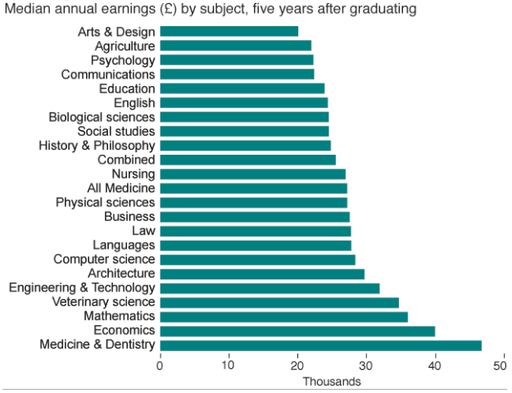
Large differences in earnings by subject
Source: DfE LEO dataset

Slide 56
Distribution of the government contribution
  Note: Excludes spending by students who do not take out loans

Slide 57
Major implications
University funding did go up by 25% – but big (unintended) changes in the incentives of universities to provide different courses.
Larger than expected government contribution (exacerbated by terrible earnings growth)
Big changes in the distribution of that contribution

Slide 58
Current solutions
Teaching Excellence Framework
      Rating universities on teaching quality (including NSS & earnings)
        Originally, proposed to directly affect tuition fees
        Could have indirect impact if it affects student choice (however this channel is weakened if excess demand)

Slide 59
Current solutions
Teaching Excellence Framework
      Rating universities on teaching quality (including NSS & earnings)
        Originally, proposed to directly affect tuition fees
        Could have indirect impact if it affects student choice (however this channel is weakened if excess demand)
Expansion of university competition
      Removal of numbers caps and reducing barriers to entry
        Could increase competition and drive down price
        Limited evidence of this so far. And exposes government to other risks (failure of universities, quality)

Slide 60
Are variable fees the answer?
How does this help?
      Potentially reduces incentives to provide low earning courses
      Reduces government costs
      Subsidy targeted more accurately (particularly if money is put back into the system).

Slide 61
Are variable fees the answer?
How does this help?
      Potentially reduces incentives to provide low earning courses
      Reduces government costs
      Subsidy targeted more accurately (particularly if money is put back into the system).
BUT the demand and supply responses are really hard to predict
      Students could increase their demand for cheaper courses
      Universities may not reduce provision of cheaper courses
        It is difficult for them respond quickly
        Also could reduce STEM provision if cross subsidising
        KEY: to know and understand costs of provision

Slide 62
Conclusion
Issues with ensuring quality in Higher Education
Big changes in recent years
      Resulted in a subsidy that is large and potentially poorly targeted
      And inadvertently generated perverse incentives for universities

Slide 63
Conclusion
Issues with ensuring quality in Higher Education
Big changes in recent years
      Resulted in a subsidy that is large and potentially poorly targeted
      And inadvertently generated perverse incentives for universities
Current solutions are improved information and competition
      Possible these will help, but it potentially expecting a lot – and the latter exposes the government to risks

Slide 64
Conclusion
Issues with ensuring quality in Higher Education
Big changes in recent years
      Resulted in a subsidy that is large and potentially poorly targeted
      And inadvertently generated perverse incentives for universities
Current solutions are improved information and competition
      Possible these will help, but it potentially expecting a lot – and the latter exposes the government to risks
Many have suggest variable fees are the solution
      This would potentially improve targeting
      BUT the demand and supply side responses are really unpredictable: more information is required

Slide 65
Thanks for listening

Slide 66
Q&A with David Robinson &
Dr. Jack Britton
Chaired by: Natalie Perera, Executive Director, Education Policy Institute

Slide 67
Should we increase spending on higher education?
Luke Sibieta, Education Policy Institute and Institute for Fiscal Studies

Slide 68
    Many justifications given for increasing spending on higher education
Browne Review 2012
“Higher education matters because it transforms the lives of individuals”
“Higher education matters because it drives innovation and economic transformation”
Dearing Report 1997
“We are particularly concerned about planned further reductions in the unit of funding for higher education. If these are carried forward, it would have been halved in 25 years. We believe that this would damage both the quality and effectiveness of higher education. ”

Slide 69
    Drivers of higher education spending over time
Focus on upfront resources provided by government to higher education institutions
Tuition fees plus teaching grants
Best measure of resources available to students
Upfront spending in England has gone from just under £4bn in 1990 to about £10 bn in 2015
Rising share of national income (0.3% to 0.5%)
Two Main Drivers
Increases in higher education participation
  Up from around 15% in 1980s to around 50% today
Increases in spending per pupil
  Down from £6,000 in 1990 to £4,500 by 1997, up to £9,000 by 2015 due to fee rises
What are the likely benefits of these different channels?

Slide 70
    Should we increase spending on higher education?
1. Assessing the benefits of increases in HE participation
2. Assessing the benefit of increased spending per student

Slide 71
    Rising share of cohorts with tertiary education
    Smaller increases in UK, but from high a base

Slide 72
    Earnings benefits of going to higher education
High causal effects on earnings seen across countries (Card, 1999)
Stable / increasing returns up to 2000s despite higher supply
Technological progress increased demand for skills faster than increase in supply of graduates (Goldin & Katz, 2009; Blundell et al, 2016
Some declines in returns since mid-2000s and lower returns in countries with higher participation (OECD, 2009)
Is HE best option for young people on the margins of going or not?
Depends what they study (Britton et al, 2016)
Evidence suggests HE better than most existing vocational qualifications (Dearden et al, 2004; Jenkins et al, 2007; McIntosh and Morris, 2016)
Will T-levels change this?
Historic apprenticeships good option, but will government target for 3 million new apprenticeships lower quality?

Slide 73
    Wider benefits of going to higher education
Improved health,
See e.g. Feinstein et al (2006), Grossman (2006)
Lower crime
  See e.g. Machin et al, (2011), Lochner, (2011)
Improved innovation
  See e.g. Jones (2005)
Potential to improve social mobility
  Though big gaps remain in HE participation by SES, particularly at high-status institutions

Slide 74
    Overall summary
Clear evidence suggesting benefits from increased higher education participation over time
Important to understand whether HE is genuinely best option for marginal learner
How good are new apprenticeships and T-levels?
What courses/institutions are marginal learners choosing ?

Slide 75
    Should we increase spending on higher education?
1. Assessing the benefits of increases in HE participation
2. Assessing the benefit of increased spending per student

Slide 76
    Strong evidence on effectiveness of early years and school spending
Clear evidence on long-term benefits of good quality early years education
Perry pre-school (Heckman et al, 2013), Abecedarian project (Anderson, 2008), Head-start (Jackson and Johnson, 2017)
Increasing evidence higher school spending per pupil improves student outcomes later in life
Pupils benefiting from US school funding reforms in 1970s had higher earnings and lower incarceration rates later in life (Jackson et al, 2014)
Higher benefits for pupils from low-income families
Notion of ‘complementarity’
Higher early years spending increases return to school spending
High early years spending must be followed up too

Slide 77
    Less evidence on effectiveness of increases to spending after school years
Little good quality evidence in UK or other countries on effects of 16-18 education or higher education spending per pupil
Weakens case for extra spending per pupil
But, should not interpret lack of evidence as evidence of no benefit
Principle of complementarity likely to apply here too:
Benefits from higher school spending increased by later investments
Surges in spending at later ages likely to offer poor value-for-money

Slide 78
    Changes to spending per pupil over time
Periodic increases in HE spending per pupil with fee increases, correcting for squeezes or reductions over prolonged periods
Long-run squeeze on FE spending, same real-terms level in 2020 as it was in 1990
Increases to early years and school spending over time
Sources and Notes: Belfield et al (2017); Higher education resources refers to all upfront spending (teaching grant and fees); Higher education subsidy refers to teaching grant plus expected long-run subsidy to fee loans

Slide 79
    Increases resources per student in higher education driven by fee rises
 | 1990 | 2000 | 2015
Early Years | n/a | £1,287 | £1,765
Primary School | £2,081 | £2,943 | £4,871
Secondary School | £3,458 | £3,821 | £6,318
Further Education (16-18) / School Sixth Form | £4,935 | £4,371 | £5,638
Higher Education | £5,912 | £5,795 | £9,250
Teaching Grant | £5,912 | £4,338 | £857
Fee income | £0 | £1,457 | £8,393

Slide 80
    UK tertiary spending high compared with other countries, and high compared with school spending
Sources and Notes: OECD Education at Glance 2017; Tertiary spending excludes R&D activities; Includes both private and public spending

Slide 81
    Overall Summary
Good case for high levels of participation in HE
But is HE still best option for marginal learner?
Weaker case for higher levels of spend per student
Spend per student high in historical and relative terms
Little evidence on increasing spend per student
But, do need a system to keep resources stable
Important not to see overall education spending as fixed pie to be distributed across stages
Principle of complementarity suggests high early investments more productive if followed up
But gap in resources between FE and HE is significant

Slide 82
Benchmarking higher education system performance
Cláudia Sarrico, Policy Analyst, Higher Education Team, OECD

Slide 83
    Benchmarking higher education system performance
A report covering much of the material included in the OECD presentation can be found here –
http://www.oecd.org/education/skills-beyond-school/Benchmarking%20Report.pdf

Slide 84
Q&A with Luke Sibieta &
Cláudia Sarrico
Chaired by: Natalie Perera, Executive Director, Education Policy Institute

Slide 85
Higher education funding: a sustainable future?
9:00 – 13:15 | Wednesday 21st March 2018

Slide 86
Rethinking higher education funding
Alternatives to the current model
Gerard Dominguez-Reig, Senior Researcher, Post-16 & Skills,
Education Policy Institute
@dominguezireig

Slide 87
    CONTENT
Options
Outcomes
How to choose

Slide 88
Options
Outcomes
How to choose

Slide 89
Options
Funding system | Key features
2018/19 system As announced at 2017 Conservative Conference | Income contingent loan system (ICL) with £25K repayment threshold (up from £21K) Fee cap of £9,250 (now frozen) Maintenance also funded via ICL Small number of courses attract teaching grants
No Fees UK Labour model | Courses funded by teaching grants only Maintenance costs covered by mix of ICL and means-tested grant
Graduate tax Potential Libdem model | Courses funded by teaching grants only, maintenance loans replaced with grants Graduates pay a tax for a number of years to contribute to the system’s funding No connection between course funding and graduate payments

Slide 90
Options
Outcomes
How to choose
Note: all modelling use system parameters as per current system with £25K repayment threshold as announced at the Conservative Conference unless otherwise stated

Slide 91
    Student debt vs graduate contributions
The notion of debt
There can be significant graduate contributions without debt, and also lower graduate contributions for similar levels of debt

Slide 92
    Graduates: winners and losers
Maintenance loans repayments
Lowest earners
Highest earners

Slide 93
    Who pays and when does the government pay?
Current system: all government contributions delayed. Taxpayer faces 1/3 of costs.
Taxpayer pays 100%
18/19 system: taxpayer contributions raise by 12pp
Graduate tax: all government contributions made upfront
No fees: Most government spending upfront, graduate contributions down significantly

Slide 94
    Impact on university funding
18/19 system: freezing fees would reduce funding in real terms over time
No Fees: may lead to reduction in university funding if no additional taxes raised or HE income ring-fenced
Graduate tax: similar impact to No Fees scenario, unless until income from graduate tax cover a significant proportion of HE spending

Slide 95
    What deal for the other 50% who don’t go to university?
Higher Education
Fee loan: £9,250
Maintenance loan: max £11,350 (average loan = £6K, students starting 2016/17)
Level 3 FE education and skills (aged 19+)
Advanced learner loans averaging £2,400 (2016/17). Loan caps between £300-£11,350 for the whole of the qualification.
No maintenance loans (some bursaries available)
And many others joining the labour market or becoming NEETS with low level qualifications
Level 4+ apprenticeships (aged 19+)
Students don’t pay. Funding bands between £2,500 and £27,000, paid for with apprenticeship levy
Apprentice salary: from £3.5/hour (circa £7k/year, less than a maintenance loan for undergraduate students)
Level 4+ FE education and skills (aged 19+)
Advanced learner loans averaging £2,400 (2016/17). Loan caps between £600-£8,600 for the whole of the qualification
No maintenance loans (some bursaries available)

Slide 96
    What deal for the other 50% who don’t go to university?
What a post-18 education and training voucher could look like: a lifetime tertiary education entitlement, which could be drawn down as a loan in whatever instalments an individual pleases, whenever they wish, and used at any approved tertiary institution (EPI’s Wolf, A., Sellen, P., Dominguez-Reig, G. (2016) Remaking Tertiary Education: can we create a system that is fair and fit for purpose?)
Would this lead to fee escalation in the FE sector?
There can be different caps across qualifications or caps on loans
Some technical education is already delivered at HEIs
Non-HE provision could improve diversity of technical education – few high-level technical qualifications are delivered outside
Low repayment expectations may suggest that bringing higher technical education under the same system isn’t advisable
RAB charge for advanced learner loans expected to be 10% higher than for HE (HL WA112640)
Only under the current form of government accounts, and a unified HE/FE loans system would address this within the current accounting framework
As HE spending is largely in the form of loans, it cannot easily be transferred to FE spending

Slide 97
Options
Outcomes
How to choose

Slide 98


So, how to choose?
 | If you want… | The trade off…
Income contingent loans | Main beneficiary to pay Less competition with other Govt spending | Problems of concept of student debt Little transparency of impact on public spending means inadequate Govt accountability
Graduate tax | Main beneficiary to pay Move away from concept of debt | Direct competition with other Govt spending due to immediate impact on deficit
No fees | Principle of “free” education | Impact on combination of: Access HE spending Govt finances Tax increases
Policy design critical for full range of outcomes e.g. access, equity, efficiency

Slide 99
EPI priorities for the Post 18 Review
Better value for money - Avoid a large further expansion in the cost of HE
  Inefficient funding for some courses
  High ancillary spending
  Principle of complementarity
Government accounting - Need to avoid current government accounting rules driving funding decisions
  Current accounting system pushes towards status quo
  Currently little political accountability for increased taxpayer costs and underselling loan book.
Incentives – Reduce institutional perverse incentives towards particular courses and pathways and ensure students have more information and more balanced incentives
  Perverse incentives created by current funding system
  Unintended consequences of variable fees
  Maintenance loans pay more than many apprenticeships

Slide 100
EPI priorities for the Post 18 Review
Wider tertiary offer - Case for developing a stronger and more coherent funding offer for non-HE post 18 funding
  Funding gap between FE and HE
  Lack of provision for high level technical skills
Progressivity - What can be done to maintain the balance?
  Lowering fees and interest rates will favour the highest earners
  Maintenance grants?

Slide 101
Q&A with Gerard Dominguez-Reig &
David Robinson
Chaired by: Natalie Perera, Executive Director, Education Policy Institute

Slide 102
The options for changing the funding of higher education
Lord David Willetts, Executive Chair, Resolution Foundation

Slide 103

EDUCATION
DAVID WILLETTS
A UNIVERSITY
March 2018

Slide 104
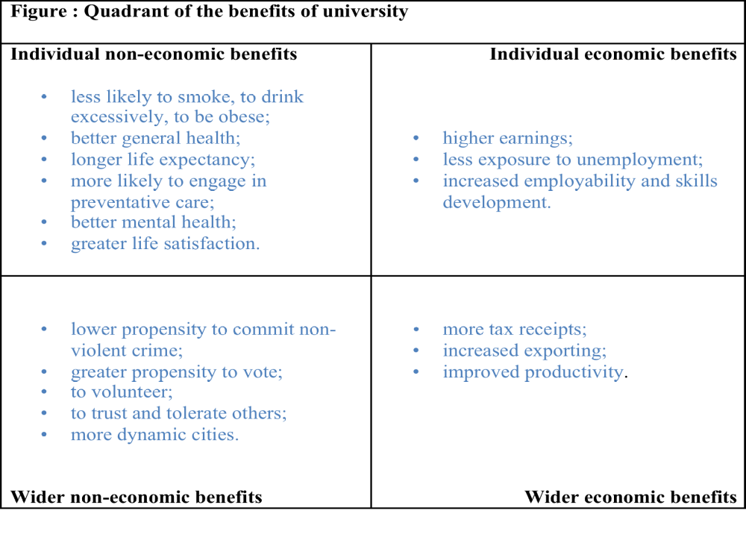
Challenging the Edusceptics: the benefits from higher education

Slide 105
Trends in staff student ratios
 | University SSR | School PTR
1980/81 | 9.1 | 18.2
1990/91 | 11.4 | 17.3
2000/2001 | 18.1 | 17.9
2010/2001 | 17.4 | 15.6
2013/2014 | 16.2 | 15.4
2014/15 | 15.4 | 15.5

Slide 106
Higher education is never a priority for public spending
Source: House of Commons Library

Slide 107
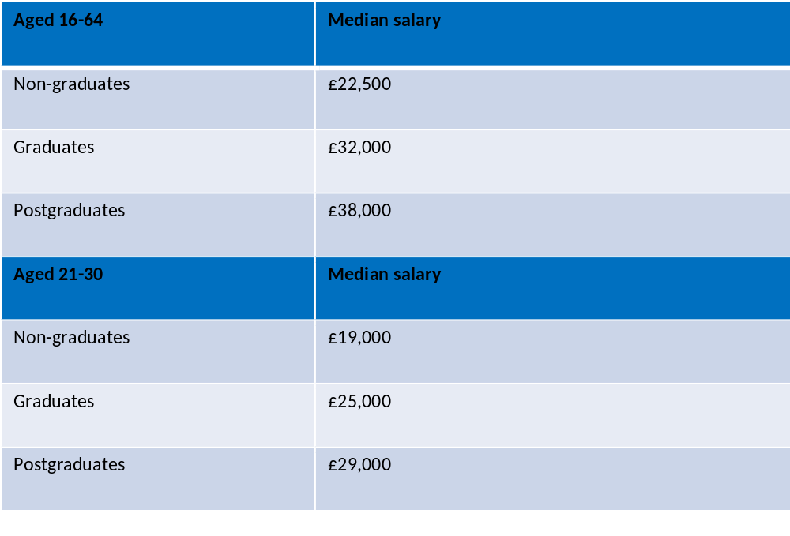
Median Wages: post-graduates, graduates, and non-graduates 2016

Slide 108
Marx was right.
“If…higher education institutions are also “free”, that only means in fact defraying the cost of education of the bourgeoisie from the general tax receipts.”
Karl Marx, Critique of the Gotha Programme 1875.

Slide 109
“Spending” is not the same as “Public spending”
You can’t bring your personal definition of public spending to the debate – and can’t bring your own tax to finance it either.
Treatment in the National Accounts on international standards – not public spending nor borrowing but do add to national debt and eventual write-offs add to PSBR.
Government Accounts are for Treasury to monitor departmental spending – that is why we have the RAB charge

Slide 110
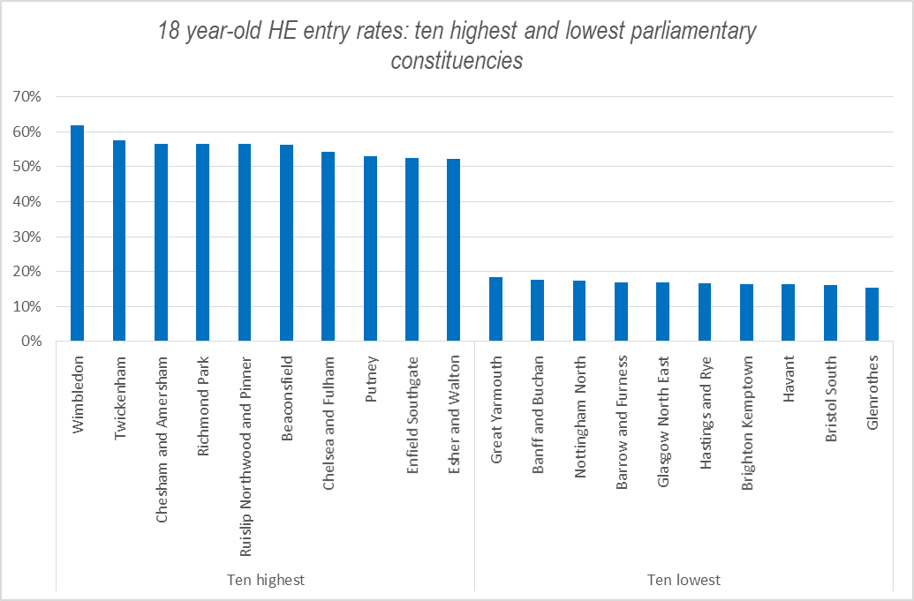
“Too many people are going”
High v Low participation areas
Source: UCAS; figures indicate HE entry rates for 18 year-olds by parliamentary constituency, 2017

Slide 111
‘Too much money is being spent’?
What the £9k fees cover
Band A-C Grant | £4,000
Old fee loan | £3,250
Access Spend | £1,000
From capital grant to commercial loans | £250
Other HEFCE grants for disabled students, opportunities fund, etc. | £500

Slide 112
Four reasons for the reformed English system
The Principle – it is progressive
The Economics – investing in human capital
The Fiscal Challenge – tackled under-funding of higher education whilst cutting public spending
The Opportunity – End of number controls

Slide 113
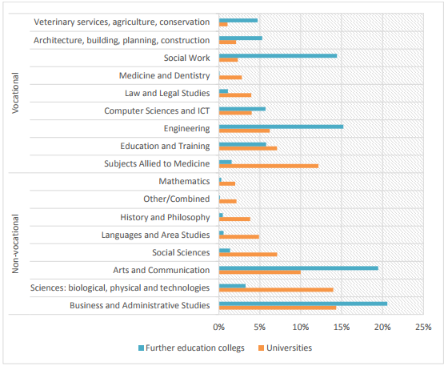
The ‘academic’ and ‘technical’ divide has gone
This arbitrary distinction bears little relevance to the educational experience
42% of students enrolled at universities (all levels) are on courses designed to offer a pathway into a specific profession. At FE colleges, that figure is 54%

Slide 114
“Good universities should charge more.”
But what makes a university “good”?
Graduates earn more because of
Social background of parents
Prior attainment of students
Geographical location
Move up rankings also because of
Research Excellence

Slide 115
Competition for students is real
Source: Higher Education Statistics Agency, figures exclude Open University, which lost 5% of its share of undergraduate students

Slide 116
Some bad ideas to change this system
Cut fees and cut resource
Differential fees – on what basis?
A graduate tax – back to public spending
Raise repayment threshold - unecessary
Shift the “spending” to non-HE – but there is no alchemy to change it into public spending to re-allocate

Slide 117
Reverse decline in part-time student
Source: Higher Education Statistics Agency

Slide 118
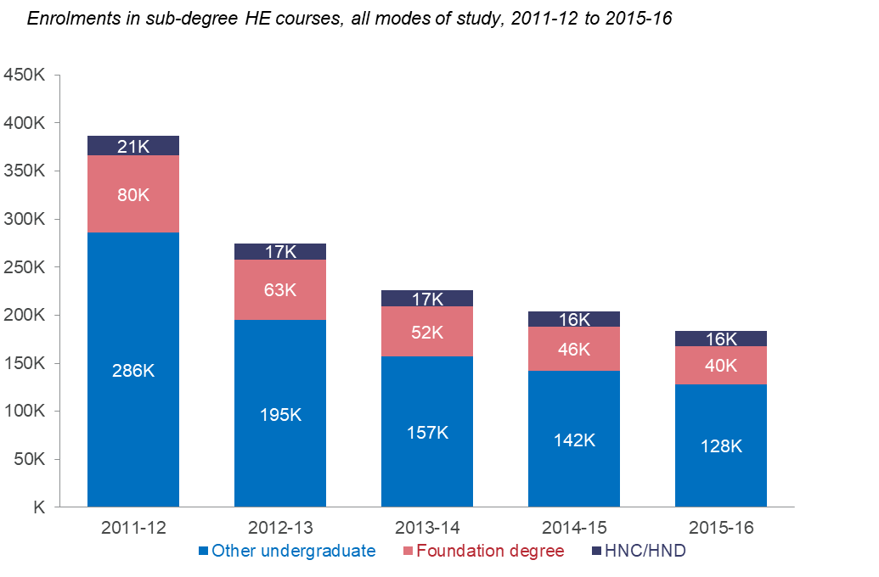
Reverse decline in sub-degree students
Source: Higher Education Statistics Agency

Slide 119
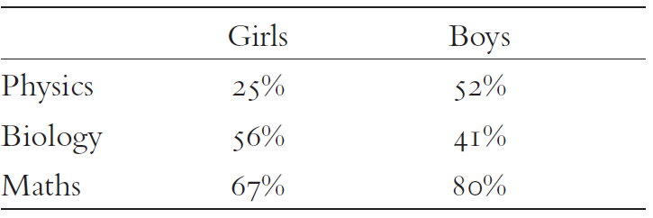
What: A broader education
Percentages of girls and boys with GCSE A* doing that subject at A Level

Slide 120
Some better ideas to improve the system
A regular five year review of the parameters of the system. (The interest rate could go. Reverse increase in repayment threshold)
Maintenance grant - more cash for students
More support for disadvantaged, sub-honours and part-time students
More funding for high cost courses – STEM
Sell stock of graduate debt to the university

Slide 121
The policy challenge
Do not damage the interests of students in higher education
Focus on doing more for the other 50%
There is no single model: different types of post 18 education and training need to be funded in different ways
English education is early, specialised and quick It should be later, broader and slower.

Slide 122
EDUCATION
DAVID WILLETTS
A UNIVERSITY
March 2018

Slide 123
Review of post-18 education and funding
Philip Augar, Chair, Post-18 education and funding review

Slide 124
Panel discussion
Dr. Jack Britton
Senior Research Economist
IFS
Prof. Chris Husbands
Vice-Chancellor
Sheffield Hallam University
Prof. Andy Green
Professor
UCL, Institute of Education
Dame Minouche Shafik
Director
LSE
Chaired by: Rt Hon. David Laws, Executive Chairman, Education Policy Institute

Slide 125
Closing remarks
Rt Hon. David Laws, Executive Chairman, Education Policy Institute

Slide 126
Higher education funding: a sustainable future?
9:00 – 13:15 | Wednesday 21st March 2018

