Slide 1

Should Ofsted hold schools to account for teacher workload and development?
Peter Sellen
November 2016
1

Slide 2



Contents
Key questions
Is there a problem to be solved?
What does Ofsted do now?
What challenges might Ofsted face if it took on a role here?
If it did, what should it focus on?
Sources – (mostly for secondary school classroom teachers)
#OfstedWhereNext
2

Slide 3
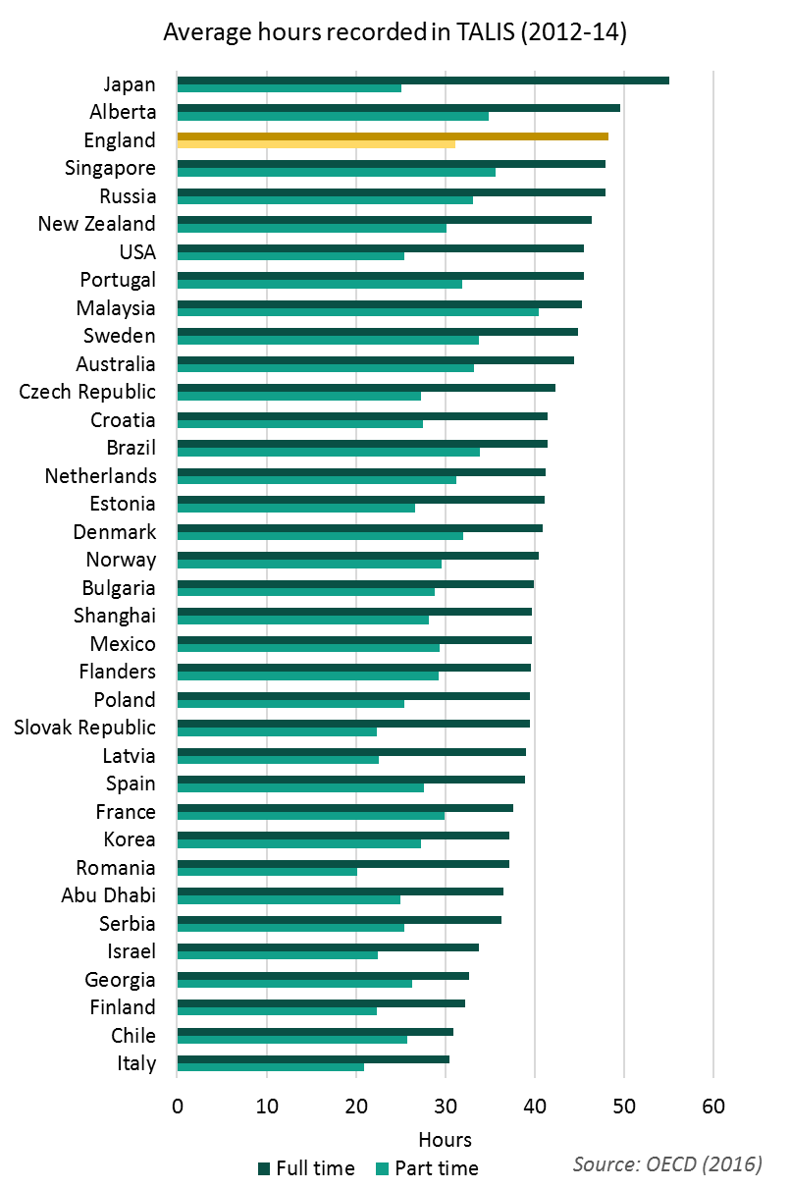
England’s teachers work
long hours
On average, full time teachers in England’s secondary schools reported working 48 hours in a sampled week in TALIS (2013), compared to 41 elsewhere
38% agreed and 13% strongly agreed that “My workload is unmanageable”
DfE Workload Diary surveys have shown that teachers in primary and secondary schools have worked at least 50 hours per week since 2000 (and leaders more)
#OfstedWhereNext
3

Slide 4
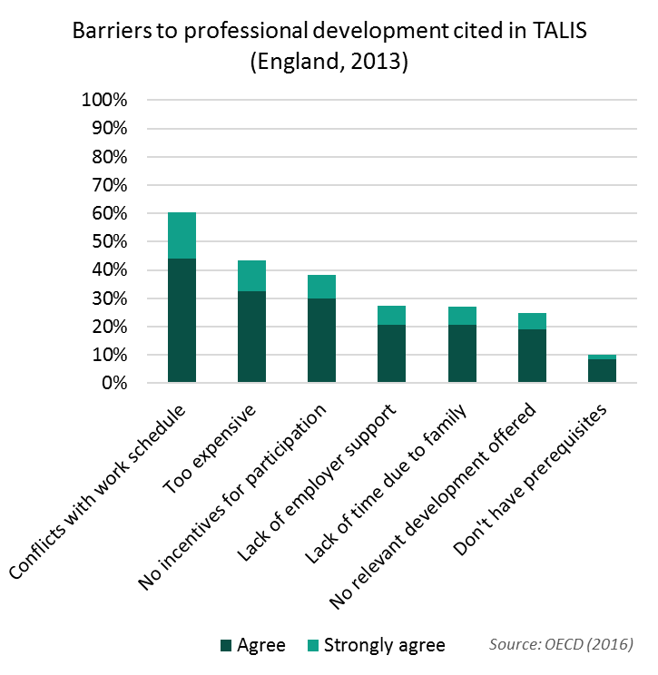
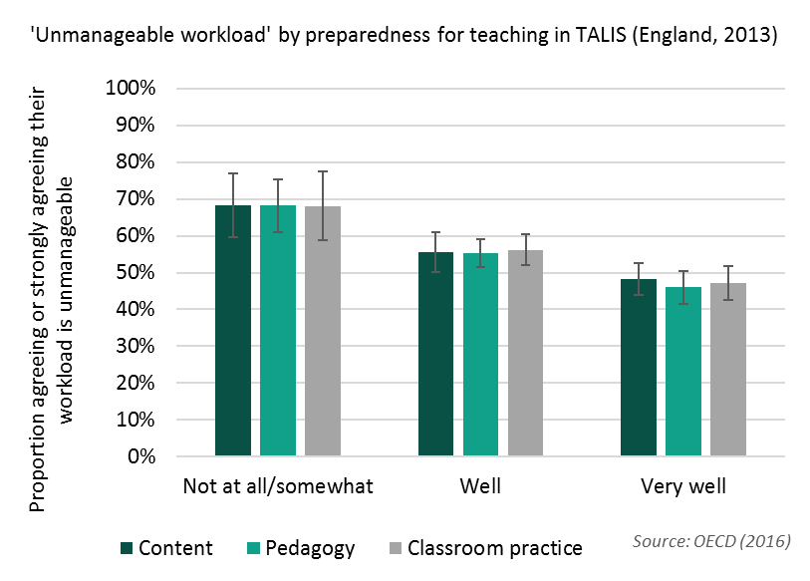
Workload and professional development are linked
#OfstedWhereNext
4

Slide 5
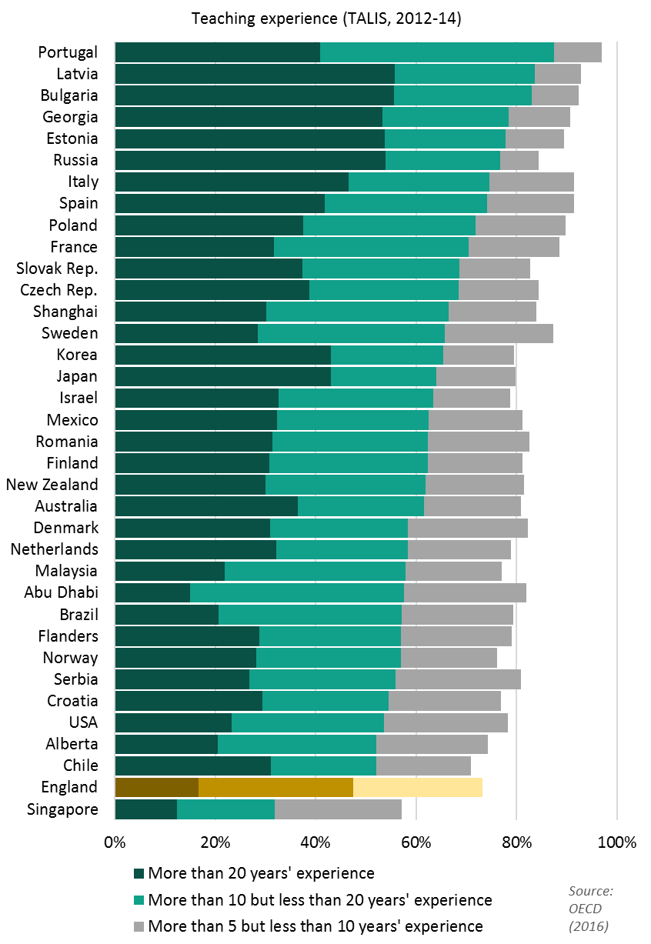
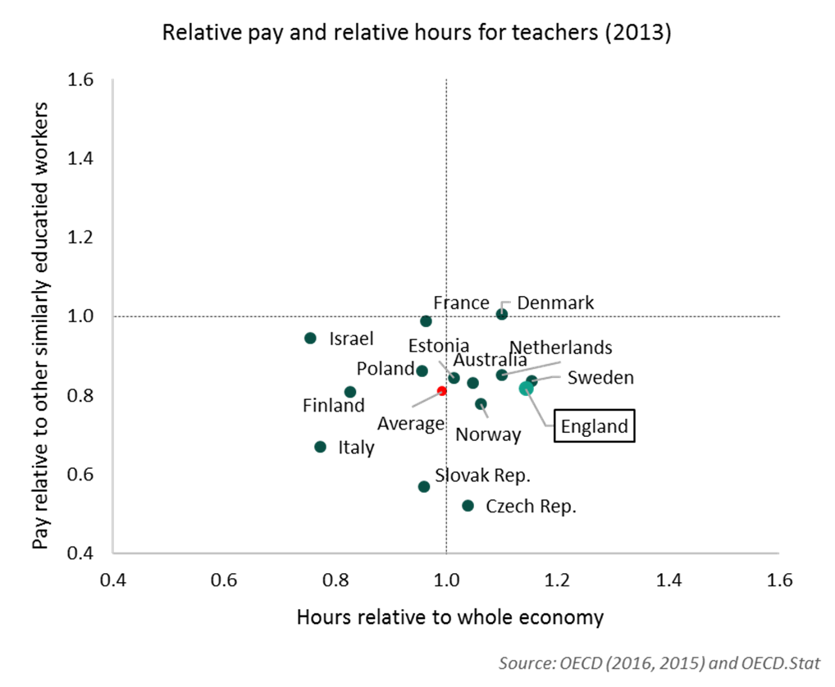
High workloads could affect teacher retention
#OfstedWhereNext
5

Slide 6
It is less clear how they affect teacher turnover (1)
Many teachers tolerate high working hours and still express high job satisfaction
13% cite an “unmanageable” workload and feel “the advantages of being a teacher don’t outweigh the disadvantages”
13% cite an “unmanageable” workload, agree that “I would like to move school if I could” but also agree that “the advantages of being a teacher outweigh the disadvantages”
Only a small proportion of teachers appear to be struggling with workload and considering that a move to another school would help
#OfstedWhereNext
6

Slide 7
It is less clear how they affect teacher turnover (2)
As of 2013, school tenures looked about average in England
But the proportion of state-sector secondary teachers leaving to other schools increased from 3.9% to 7.9% between 2011 and 2015 (DfE, 2016)
  Is a more competitive market emerging with teachers in short supply, or is this just an effect of academisation?
  On average, the wages of teachers that left for another job recently were ten per cent lower than for those that stayed in teaching (NfER, 2015)
    Would greater use of pay flexibilities and more job moves encourage schools to offer a different combination of salary and working hours?
#OfstedWhereNext
7

Slide 8
Ofsted’s remit covers staff development but not wider working conditions
Common Inspection Framework:
  “Inspectors will make a judgement on the effectiveness of leadership and management by evaluating the extent to which leaders, managers and governors…improve staff practice and teaching, learning and assessment through rigorous performance management and appropriate professional development”
  This includes: “…how well leaders ensure that the school has a motivated, respected and effective teaching staff to deliver a high quality education for all pupils”
CPD should be incentivised via link to pupil outcomes, and the quality of teaching, learning and assessment – if the horizon for decision-making is long enough
Key evidence on working conditions and development might come from staff surveys, but analysis not routinely reported
Ofsted is not responsible for assessing teacher well-being or workload
#OfstedWhereNext
8

Slide 9
This does not appear to have incentivised formal CPD
Courses/workshops, conferences/seminars, observation visits, in-service training
#OfstedWhereNext
9

Slide 10
Ofsted’s ‘myth-busting’ is an important step
In TALIS, average full-time hours worked did not vary significantly across Ofsted ratings, but the proportion citing ‘unmanageable workloads’ was 9%pts higher in satisfactory or inadequate schools compared to good schools
In TALIS, 50% disagreed and 27% strongly disagreed that “The accountability system [including Ofsted] does not add significantly to my workload”
In the 2014 Workload Challenge, many teachers highlighted burdensome requirements in schools and linked them to perceptions of what Ofsted “wanted to see”
Ofsted: “While inspectors will consider how written and oral feedback is used to promote learning, Ofsted does not expect to see any written record of oral feedback provided to pupils by teachers” etc
#OfstedWhereNext
10

Slide 11
TALIS figures suggest Ofsted would struggle to objectively identify ‘high workload’ schools if it were asked to (1)
Variation in weekly hours is higher within schools than between schools
Around a fifth of schools had a median of 45 or fewer hours for FT teachers
A fifth had a median of over 52
Within schools: average 20:80 range was 20 hours
An imperfect snapshot with small samples, but could Ofsted do much better in practice?
(Includes only schools with at least 10 full time respondents to question)
#OfstedWhereNext
11

Slide 12
TALIS figures suggest Ofsted would struggle to objectively identify ‘high workload’ schools if it were asked to (2)
Around half of teachers agreed or strongly agreed that their workload was “unmanageable”. Some schools had relatively high proportions
But you would expect to see examples of this if relying on small samples, even if there were no ‘school effect’
Ofsted could obtain a broader indication from staff surveys, but with the risk of biased samples and reliance on subjectivity
(Includes only schools with at least 10 respondents to question)
#OfstedWhereNext
12

Slide 13
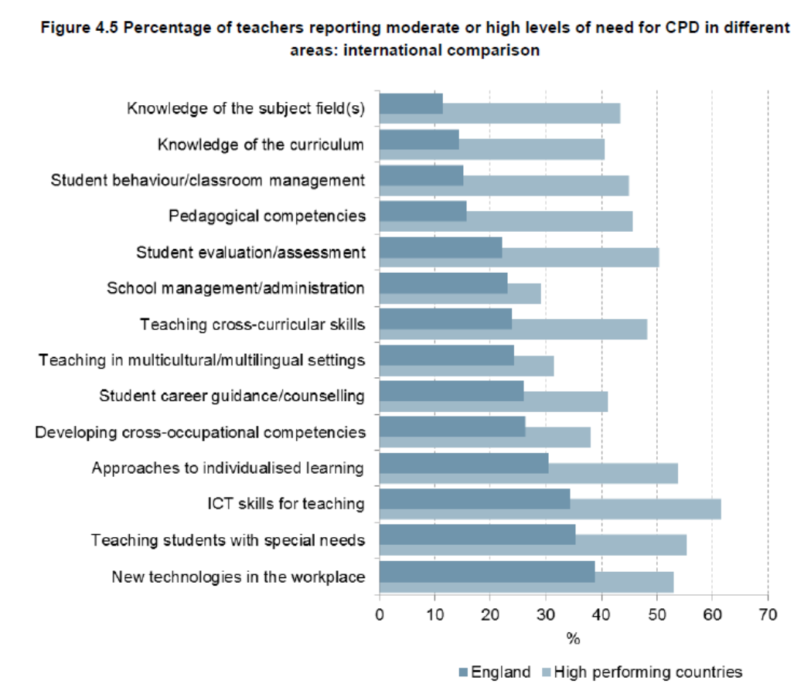
A tougher stance on professional development in the system is needed, but we should avoid a ‘tick box’ exercise
For most subjects covered, less than 40% of England’s teachers reported a ‘moderate’ or ‘large’ impact on their teaching in TALIS
These rates tended to be much lower than those of high performing countries (DfE, 2014)
England’s teachers tended not to report a great need for professional development (see chart)
Source: DfE (2014) TALIS National Report
#OfstedWhereNext
13

Slide 14
Conclusions
Something needs to be done and Ofsted’s recent efforts are in the right direction
Hard scrutiny of working conditions and professional development would be difficult
Perhaps first look to:
  Probe school leaders in more detail on how the teaching quality observed has been delivered and give this more prominence in reports
  Check for processes that would allow workload and other well-being issues for individual teachers or departments to be identified and dealt with
  Increase focus on management skills of middle leaders
  Check for understanding and management of the links between work schedules and informal professional development and practices
  Ensure that improvement plans have a long term perspective
  Research the effectiveness of staff surveys, exploring bias in response rates
#OfstedWhereNext
14

Slide 15

epi.org.uk/report/teacherworkload/
@EduPolicyInst
#OfstedWhereNext
www.epi.org.uk
#OfstedWhereNext
15

